Slide 1
AUTOML libraries
What is AutoML? Automated Machine Learning (AutoML), refers to automating the steps of data preprocessing, model selection, hyper parameter tuning, and sometimes, feature engineering and model deployment, involved in machine learning.
Why AutoML?
Simplify machine learning workflows.
Save manual time and effort.
Bridge the gap between beginners and advanced users, and enabling data scientists and business users to work more efficiently.

Slide 2
H2o.ai
Requires JRE (Java Runtime Environment) to be setup to run locally.
Automates data preprocessing, model selection and hyper-parameter tuning.
Distributed algorithms- enabling parallel processing on multiple nodes.
Supports optimized implementation of algorithms in the following:
Regression
Classification
Variations of random forest, such as, Extremely Randomized Forest, Distributed Random Forest and Isolation Random Forest, Generalized Linear Models (GLMs), Gadient Boosting Machines (GBMs), that are designed to work at scale, Time-series forecasting applications.
Clustering
PCA, Permutation Variable Importance, Dimentionality Reduction using SVD
Tf-Idf, Word vectorizer
H2O AutoML – displays up to top 20 (default = 10) best models in regression and classification analysis, with the least RMSE, rank-wise.
Best usecases: Large-scale datasets and enterprise use cases.

Slide 3
Special features
Built for Big Data and integrates well with distributed frameworks like Hadoop, Spark, and Kubernetes. It enables parallel processing and can run on multiple nodes.
Accessible APIs for Python, R, Java and Scala.
User-friendly web interface and Integration with Data Lakes, such as, HDFS, S3, and Azure Blob Storage.
Provides detailed summaries of models and customizable solutions.
End-to-end AI Lifecycle on H2O.ai cloud.
Explainable AI (XAI) - returns residual analysis, learning curve plot, variable importance, model correlation, SHAP summary, PDP and ICE plots for each feature of the best performing model, Infogram plot.
Enterprise grade model security, compliance (with XAI and traceability) and robustness.
Open-source, resource-efficient and proven industry adoption by the world’s largest organizations across Finance, Healthcare, Retail and Manufacturing.

Slide 4
TPOT (Tree-based Pipeline Optimization Tool)
Extensively supports classification and regression algorithms.
Works only on preprocessed data (cannot handle categorical variables).
Allows feature selection and hyper-parameter tuning using a parameter called ‘config_dict’, that takes in inputs of specific TPOT feature selection methods, such as TPOT light, TPOT MDR, TPOT sparse, TPOT NN, TPOT CuML, or model and hyper-parameter values.
Allows parallel training on Dask clusters.
Take notoriously large amounts of time and computing power to train neural network models.

Slide 5
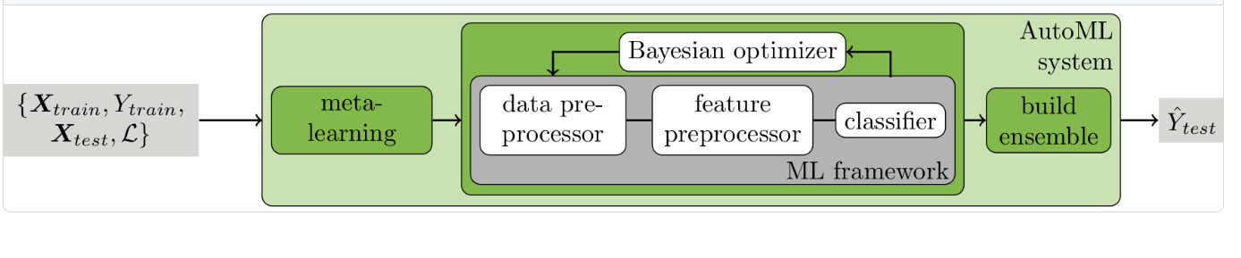
AUTO-SKLEARN
To run locally, requires installations of:
GCC Compiler
Linux Environment
Python 3.10 version
Supports regression and classification tasks (can work on data that is not preprocessed)
Also supports meta-learners and complex ensemble models, hence, computationally expensive for large datasets, but, interpretable.
Uniqueness – Generates output with different transformations and hyperparameter selections.

Slide 6
SAMPLE OUTPUTS
autosklearn.regression.AutoSklearnRegressor Output of trials:
SimpleRegressionPipeline({'categorical_encoding:__choice__': 'one_hot_encoding', 'imputation:strategy': 'most_frequent', 'preprocessor:__choice__': 'feature_agglomeration', 'regressor:__choice__': 'adaboost', 'rescaling:__choice__': 'quantile_transformer', 'categorical_encoding:one_hot_encoding:use_minimum_fraction': 'True', 'preprocessor:feature_agglomeration:affinity': 'manhattan', 'preprocessor:feature_agglomeration:linkage': 'average', 'preprocessor:feature_agglomeration:n_clusters': 257, 'preprocessor:feature_agglomeration:pooling_func': 'median', 'regressor:adaboost:learning_rate': 0.13904708846178393, 'regressor:adaboost:loss': 'linear', 'regressor:adaboost:max_depth': 8, 'regressor:adaboost:n_estimators': 464, 'rescaling:quantile_transformer:n_quantiles': 1819, 'rescaling:quantile_transformer:output_distribution': 'uniform', 'categorical_encoding:one_hot_encoding:minimum_fraction': 0.1026144927608074}
autosklearn.classification.AutoSklearnClassifier Output of trials :
SimpleClassificationPipeline({'balancing:strategy': 'none', 'categorical_encoding:__choice__': 'one_hot_encoding', 'classifier:__choice__': 'libsvm_svc', 'imputation:strategy': 'most_frequent', 'preprocessor:__choice__': 'categorical_encoding:one_hot_encoding:use_minimum_fraction': 'True', 'classifier:libsvm_svc:C': 20.269651182050794, 'classifier:libsvm_svc:gamma': 0.0009326051547535202, 'classifier:libsvm_svc:kernel': 'rbf', 'classifier:libsvm_svc:max_iter': -1, 'classifier:libsvm_svc:shrinking': 'False', 'classifier:libsvm_svc:tol': 1.9176814818606268e-05, 'preprocessor:extra_trees_preproc_for_classification:bootstrap': 'False', 'preprocessor:extra_trees_preproc_for_classification:criterion': 'entropy', 'preprocessor:extra_trees_preproc_for_classification:max_depth': 'None', 'preprocessor:extra_trees_preproc_for_classification:max_features': 0.4242777824925543, 'preprocessor:extra_trees_preproc_for_classification:min_samples_leaf': 8, 'preprocessor:extra_trees_preproc_for_classification:min_samples_split': 20, 'preprocessor:extra_trees_preproc_for_classification:n_estimators': 100, 'categorical_encoding:one_hot_encoding:minimum_fraction': 0.010000000000000004}

Slide 7
MLBox
.
Requires Python 3.10 version
Aims at data preprocessing, feature selection, model selection, and hyperparameter optimization.
Specialities: Data preprocessing, optimization using Bayesian optimization technique for improved predictions, clear and interpretable outputs.
Designed for parallel computation, speeding up the AutoML pipeline.
Limitations – Supports fewer algorithms and limited customizations.
Best usecases – Potential scoping and PoC projects with tight deadlines.

Slide 8
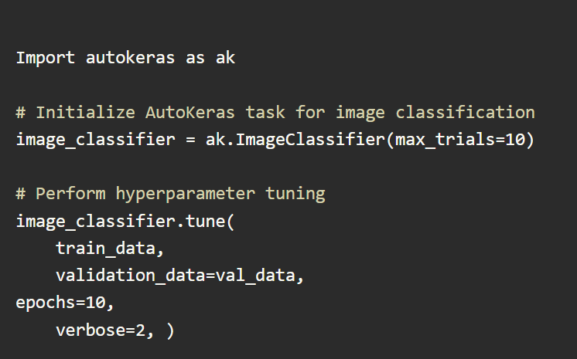
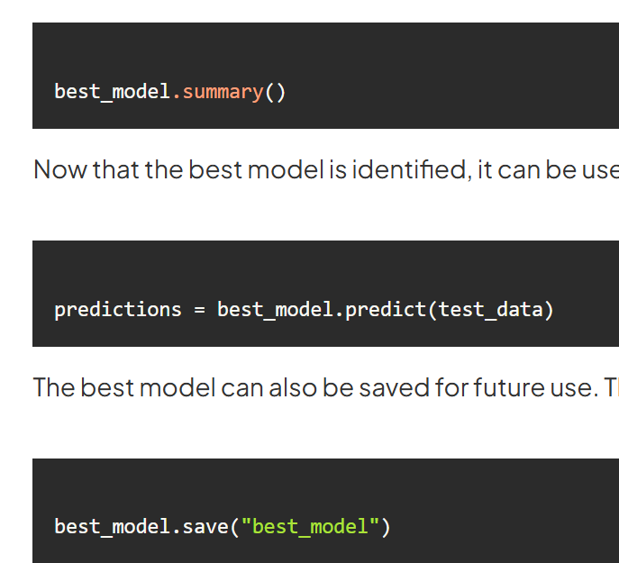
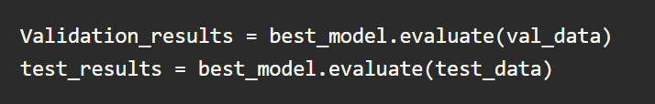
AUTOKERAS
Specially designed for deep learning and neural architecture search (NAS)
Offers end-to-end solution for deep learning, right from data preparation to model deployment.
Customizable and designed to scale
Provides detailed summary, XAI features, like SHAP, LIME, Grad-CAM and feature importance analysis.
Applications - Image Classification, Text Classification, Regression and Transfer Learning

Slide 9
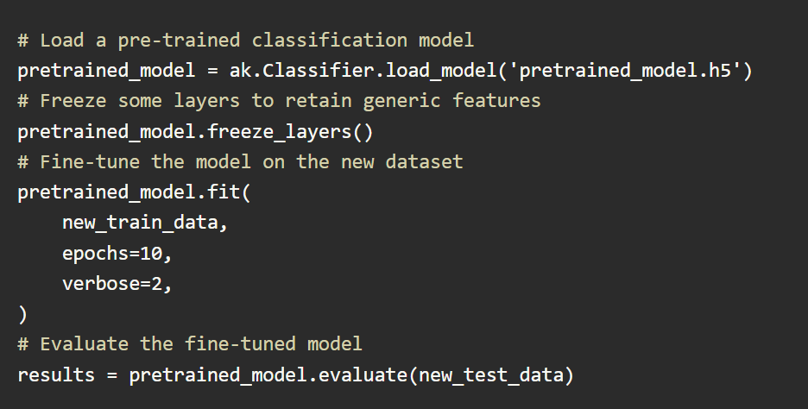
AUTO KERAS - Transfer learning and limitations
Limitations:
High Customization: AutoKeras may not support highly customized model architectures beyond its predefined blocks, like, TensorFlow or PyTorch.
Complex Pipelines: Handling complex data preprocessing pipelines, like custom data augmentation or transformations, not supported.
Resource constraints: Exhaustive hyperparameter tuning can be computationally expensive

Slide 10
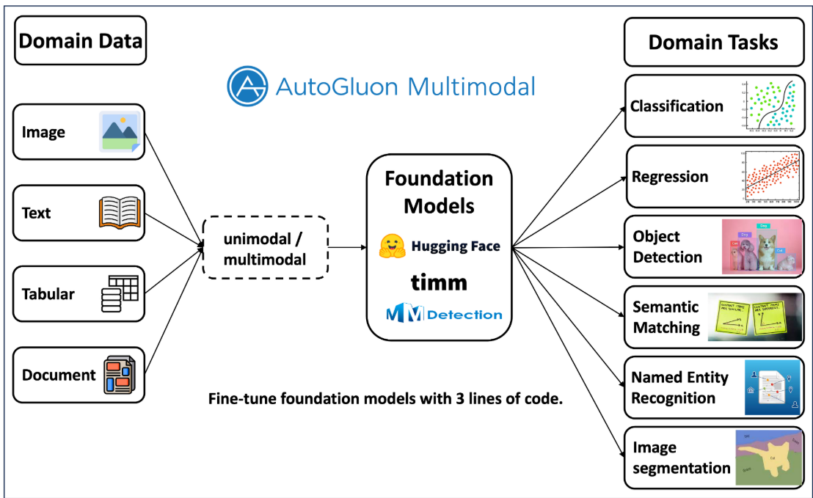
AUTOGLUON
Pros | Cons
Simple, straightforward and short codes. Can process categorical variables automatically. | Special data frames, processing required for time-series forecasting, text, image tasks.
Interpretable summaries, with .pkl files of all models saved. Leaderboard feature available. | Model customization and feature selection is not supported.

Slide 11
PYCARET
Applications: Classification, Regression, Clustering, Anomaly detection, NLP, Time Series Forecasting
Requires preprocessed data
Hosts its own set of datasets downloadable from package, ‘from pycaret.datasets import get_data’
Low-code and beginner friendly
Integrates well with pandas, scikit-learn, and other Python ML libraries
Uses XAI tools – SHAP, feature importance plot, Residual plot, PDP.
Supports parallel processing, with input parameter, ‘n_gpus’
Model selection and customizations are not supported

Slide 12
LUDWIG
Heavy dependency on Dask environment.
Automates feature engineering, model selection, hyper parameter tuning, and evaluation.
Supports regression, classification, NLP, time-series forecasting, image classification applications.
Supports parallel processing with a parameter ‘gpus’ while initializing the model training.
Pros | Cons
Low Code and declarative YAML-based configurations. | Lack of customization for model selection, feature selection
Suitable for beginners and experienced users. | Not as robust as some enterprise-focused libraries
Handles multimodal data and provides quick prototyping | Does not support Explainable AI (XAI)

Slide 13
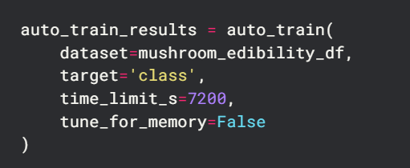
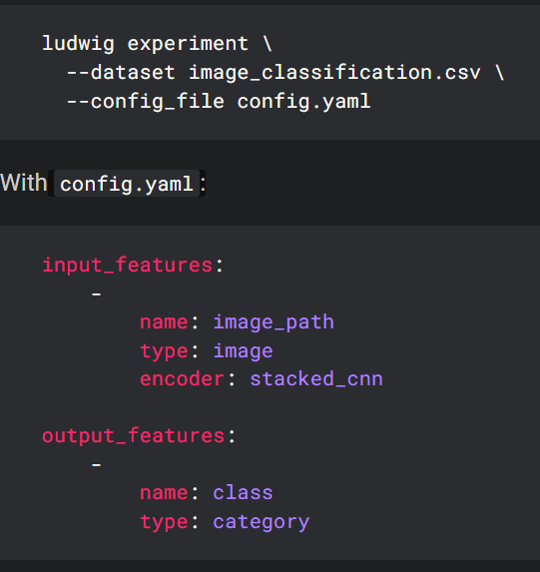
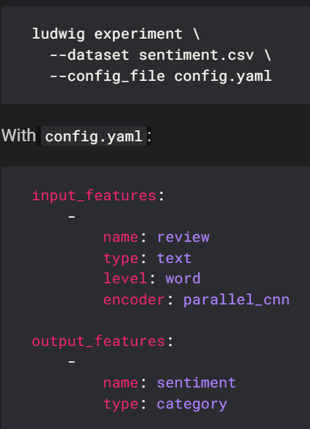
EXAMPLE CODE
Regression and Classification [Tabular data]:
Optional parameter: ‘user_config’
Target-type specification for ‘numerical’ label: user_config={'output_features': [{'column': 'TripType', 'name': 'TripType', 'type': 'category'}]}
Metric, target specification: user_config={'hyperopt': {'goal': 'maximize', 'metric': 'accuracy', 'output_feature': 'class'}}
Text and image data:
Run using config.yaml file

Slide 14
EVALML
Heavily dependent on Dask, performs parallel processing using Dask clusters.
Supports data preprocessing, classification and regression
Hosts it’s own set of 6 datasets- churn, diabetes, fraud, breast_cancer, weather, wine- importable using extension, ‘evalml.demos’. Eg. evalml.demos.load_churn()
Does not support high customization needs
Class implementation of the different processes
Examples:
class evalml.preprocessing.TrainingValidationSplit(test_size=None, train_size=None, shuffle=False, stratify=None, random_seed=0)
class evalml.pipelines.TimeSeriesImputer(categorical_impute_strategy='forwards_fill', numeric_impute_strategy='interpolate', target_impute_strategy='forwards_fill', random_seed=0, **kwargs)
class evalml.pipelines.XGBoostClassifier(eta=0.1, max_depth=6, min_child_weight=1, n_estimators=100, random_seed=0, eval_metric='logloss', n_jobs=12, **kwargs)

Slide 15
Comparison between the libraries
Feature | H2O.ai | TPOT | Auto-Sklearn | MLBox | AutoKeras | Autogluon | PyCaret | Ludwig | EvalML
Setup required/ Limitations | Yes - JRE env. | No | Yes -GCC, Linux | Yes - Python 3.10 env | Yes Python 3.10 env. | No | No | Yes- Dask cluster | Yes- Dask cluster
Regression/ Classification | Yes | Yes (clean data) | Yes | Yes | Yes | Yes | Yes (clean data) | Yes | Yes
Preprocessing support | Yes | No | No | Yes | No | No | No | No | Yes
Clustering support | Yes | No | No | No | No | No | Yes | No | No
Customization support | Yes | Yes | Yes | No | No | No | No | No | No
Explainable AI (XAI) | Yes | No | No | No | Yes | No (Easy integration) | Yes | No | No
Parallel processing | Yes | Yes | Yes (Dask) | Yes | No | No | Yes | Yes | Yes
Unique feature | Big Data | Customization support | Tuning | Scoping, PoC | Deep Learning | Multimodal input data | Multiple applications | YAML-based | Parallel process

Slide 16
MODEL-METRICS COMPARISON
Model-metrics / Libraries | H2O.ai | TPOT | Autogluon | PyCaret
Regression model | Gradient Boosting Machine (GBM) | AdaBoostRegressor | WeightedEnsemble_L2 | K Neighbors Regressor
Metric value (R2) | 0.45065 | 0.89624466 | 0.720034 | 0.9847
Classification model | Stacked ensemble model | GradientBoostingClassifier | WeightedEnsemble_L2 | Decision Tree Classifier
Metric value (accuracy) | 0.9566092 | 0.92334869 | 0.997449 | 1.0000
Regression dataset: Tips.csv from Seaborn
Classification data: cars_20mpg.csv from https://s3.amazonaws.com/h2o-public-test-data/smalldata/junit/cars_20mpg.csv

Slide 17
AUTOML ON PLATFORM AND CLOUD
Feature | DataRobot | Azure AutoML | AWS SageMaker Autopilot | Google Cloud AutoML | RapidMiner
Type | Platform | Cloud Service | Cloud Service | Cloud Service | Platform
Ease of Use | Low-code/no-code with GUI, Python, R APIs | Python SDK, GUI in Azure Studio | Python SDK, GUI in AWS Console | GUI in GCP Console | Drag-and-drop GUI, Python/R integrations
Target Users | Business analysts, data scientists | Developers, data scientists | Developers, data scientists | Developers, data scientists | Business analysts, data scientists
Applications | Classification, regression, time-series, anomaly detection, clustering | Classification, regression, time-series forecasting | Classification, regression, time-series forecasting | Classification, regression, NLP, image recognition | Classification, regression, time-series, clustering, text mining
Explainability (XAI) | Advanced global and local explainability with feature impact and SHAP | Global feature importance, SHAP | Feature importance, SHAP explanations | Basic feature importance | Feature importance, decision-making logic, compliance tools

Slide 18
Comparison
Feature | DataRobot | Azure AutoML | AWS SageMaker Autopilot | Google Cloud AutoML | RapidMiner
Preprocessing | Automated feature engineering and data preparation | Automated feature selection, normalization | Automated feature engineering and selection | Automated feature selection, text/image preprocessing | Data cleansing, normalization, and transformation
Best Use Cases | Enterprise-level ML with AutoML for quick deployment and monitoring | ML in Azure environments with high integration into Microsoft ecosystem | ML for AWS environments and big data pipelines | NLP, image recognition, and model building within Google Cloud | Enterprise data science, predictive maintenance, customer analytics
Worst Use Cases | Highly customized ML models or niche algorithms | Non-Microsoft ecosystems | Non-AWS ecosystems | Non-Google environments | Complex neural networks, real-time systems
Key Features | AutoML, deployment monitoring, MLOps | Time-series forecasting, integrations with Azure ML pipelines | AutoML, real-time inference, integration with AWS services | State-of-the-art NLP and image-based modeling | No-code workflows, AutoML, explainable AI, on-premises deployment

Slide 19
Feature | DataRobot | Azure AutoML | AWS SageMaker Autopilot | Google Cloud AutoML | RapidMiner
Clustering | Yes | Limited | No | No | Yes
Dimensionality Reduction | Yes | Yes | Limited | Limited | Yes
Integration with Big Data | Yes (e.g., Spark, Hadoop) | Yes (Azure Synapse, Data Lake) | Yes (S3, Redshift, EMR) | Yes (BigQuery) | Yes (Hadoop, Spark)
Deployment Options | Cloud, hybrid, or on-premises | Cloud and hybrid | Cloud | Cloud | Cloud, on-premises, and edge
Explainability Tools | SHAP, PDPs, global/local feature analysis | SHAP, global feature importance | SHAP, feature importance | Basic feature importance | SHAP-like feature importance, visuals
Time-Series Support | Yes | Yes | Yes | Limited | Yes
Parallel Processing | Yes | Yes | Yes | Yes | Yes (multi-threaded, supports Spark and Hadoop)

Slide 20
Feature | DataRobot | Azure AutoML | AWS SageMaker Autopilot | Google Cloud AutoML | RapidMiner
Scalability | Enterprise and cloud-native deployments | Within Azure infrastructure | Scales with AWS infrastructure | Scales with Google Cloud infrastructure | Spark, Hadoop, and enterprise systems
Customizability | Medium (API and Python/R integration) | High (SDK allows for extensive customization) | High (Python SDK and API support for custom models) | Medium (more suited for predefined models and datasets) | Limited (drag-and-drop GUI limits deep customization)
Pros | - Powerful AutoML - Advanced explainability - Strong deployment tools | - Extensive integration with Azure ecosystem - Excellent for time-series forecasting - High scalability | - Seamless integration with AWS ecosystem - High scalability - Real-time inference | - Specialized NLP and image recognition - Easy-to-use interface | - Intuitive GUI - Full ML lifecycle support - Rich preprocessing tools
Cons | - Expensive - Not suited for small businesses - May not handle custom deep learning | - Focused on Azure ecosystem - May have a learning curve for non-Microsoft users | - Focused on AWS ecosystem - May not handle niche use cases | - Tightly bound to GCP - Limited support for unsupervised tasks | - Expensive - GUI may limit custom workflows - Not suited for real-time use cases

Slide 21
THANK YOU
- By Shruti Sharada S

